Slide 1
Chrome Extension
Nov 10, 2016
For Hackathon
Team Members:
Kenny
Subin
Vinanti

Slide 2
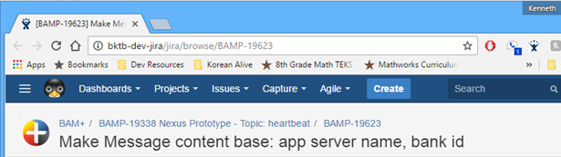
What we want to do
Revise existing JIRA Shortcut Chrome Extension to include parent topic in the shortcut
Before:
BAMP-19623: Make Message content base: app server name, bank id
After:
BAMP-19338 Nexus Prototype - Topic: heartbeat BAMP-19623: Make Message content base: app server name, bank id

Slide 3
Chrome Extension Components
Manifest.json
Page action “popup.html”
Loaded when the button is clicked
Initiator
Content script
Loaded along with the content page
Can access current page element
Background script
Always loaded on the background
Can be used for saving/loading button-specific option
Options page

Slide 4
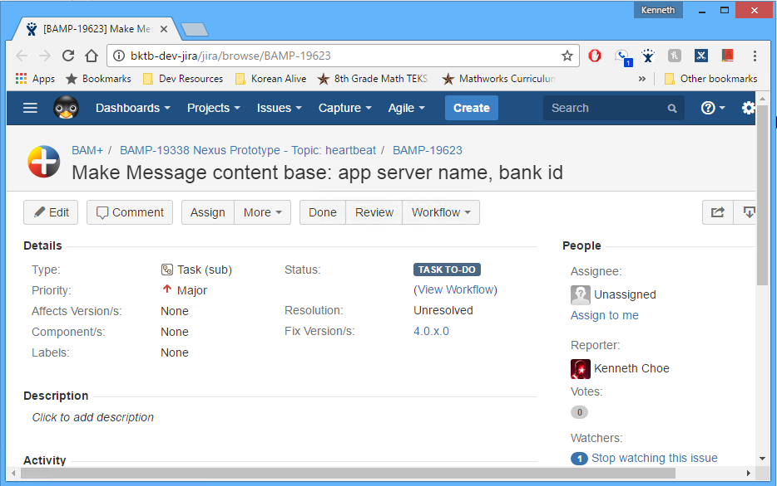
What happens when you click the button?
0. Prep: config is loaded
popup.html is loaded – show “copied”
popup.html executes popup.js
popup.js calls bg.js function
Copy the result to clipboard
Background scripts
Config.js
content.js
Get parent issue content
Bg.js
Ask content.js for parentIssue info
Construct full link using option configuration

Slide 5
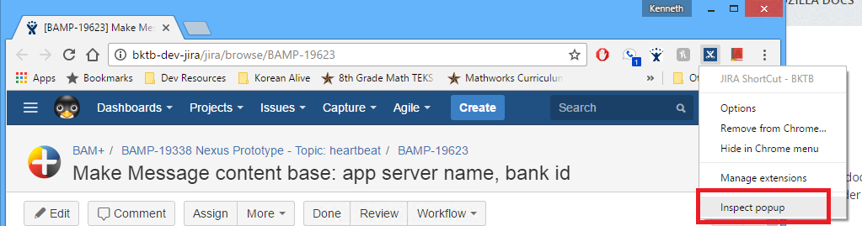
Debugging Popup JavaScript
On the html page, right-click on the button
Select Inspect popup
On the console, you can run javascript function defined in the pop-up javascript file manually

Slide 6
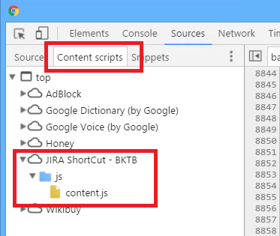
Debugging Content Script
On the html page, click F12 (developer tool)
Set breakpoint and click the button

Slide 7
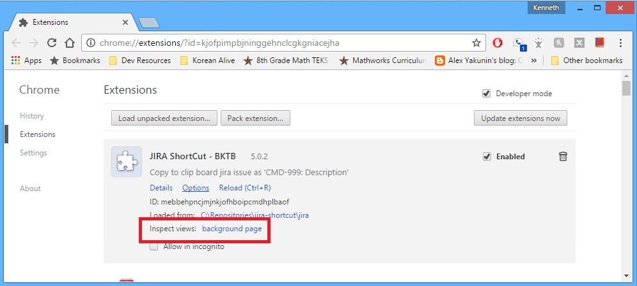
Debugging Background Script
Go to chrome://extensions
Click Inspect views: background page
Set breakpoint, go to the content page and click the button

Slide 8
Demo
Run without debugging
Paste on notepad, paste on word, click the links
Turn on all the debugging breakpoints and run again

Slide 9

Notes:
Learning to write clean code is hard work, it requires more than just the knowledge of principles and patterns.

